Slide 1
-1
+1 & -2
2
1

Slide 2
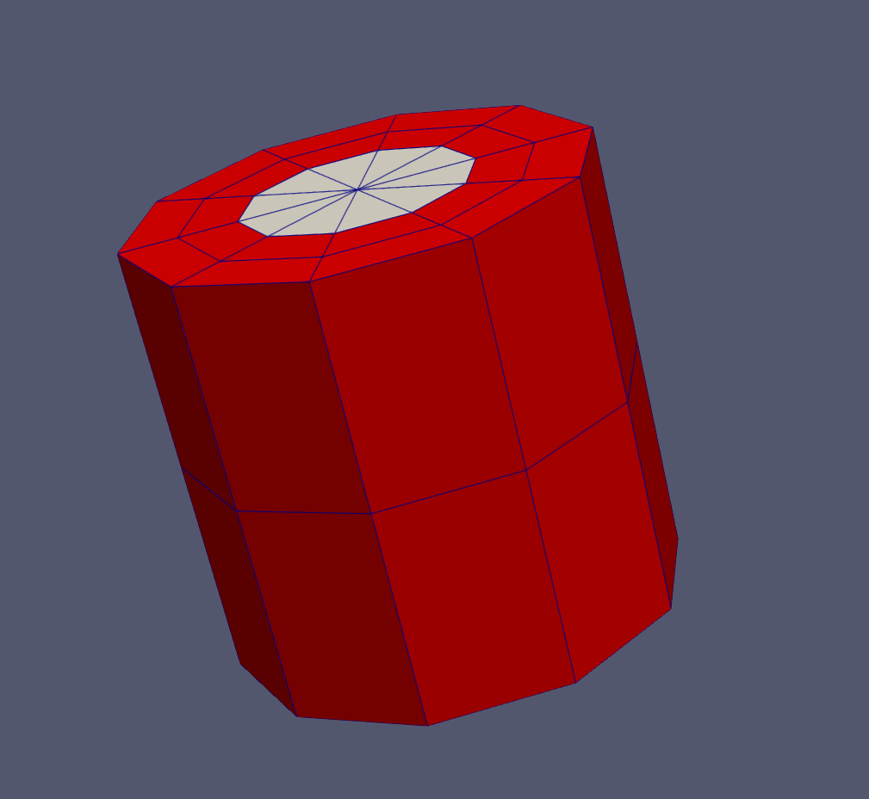

Slide 3


4
Results
Multigroup cross sections
3
2
1
CSG model from mesh
User-created mesh

Slide 4
Document
Geometry
Surface
coeffs:
id:
type:
Surface
boundary:
coeffs:
id:
type:
Cell
id: [combinations of surface ids]
material:
region:
universe:
Cell
id: [combinations of surface ids]
fill:
region:
universe:

